Slide 1
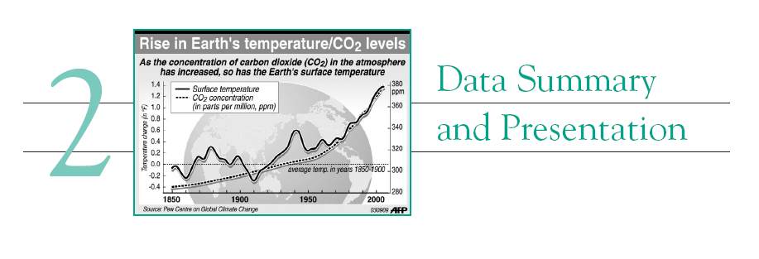
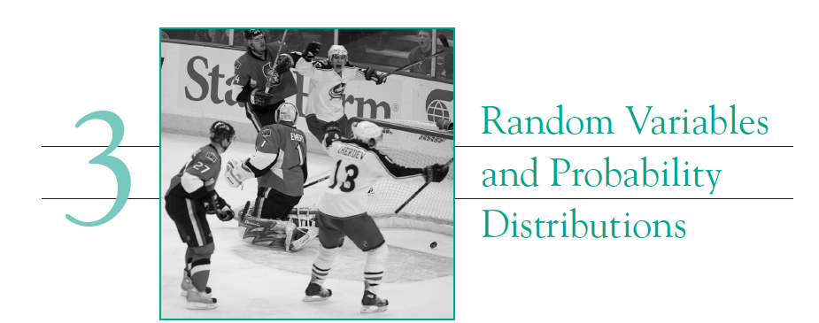
Review for Exam-1

Slide 2


Representative picture. Obtained from Google Images

Slide 3
Probability density
Time between calls

Slide 4

$$\overline{T}$$
Time between calls (T)
Observation No

Slide 5
Number of occurrence
Time between calls

Slide 6

Dot diagram for $\overline{T}$

Slide 7


Histogram for for $\overline{T}$
Number of occurrence
$$\overline{T}$$

Slide 8
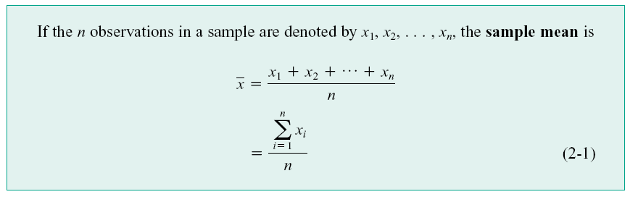
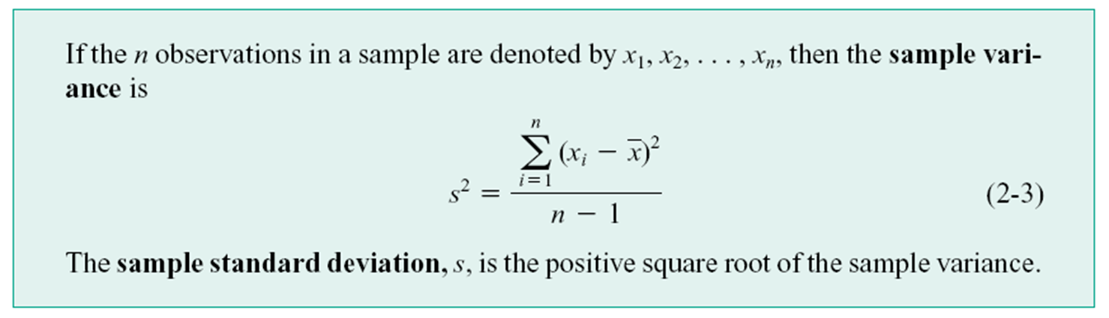

Slide 9
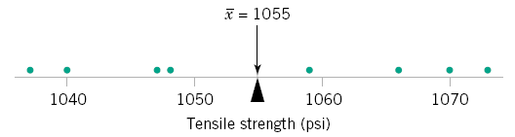

Slide 10
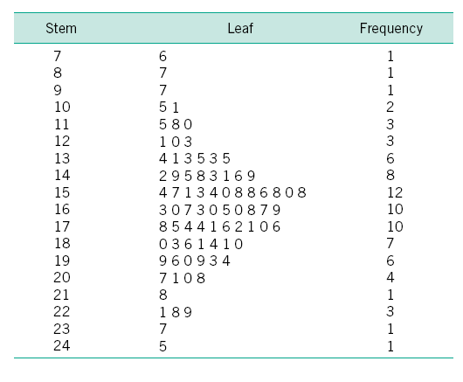
The “Key”

Slide 11
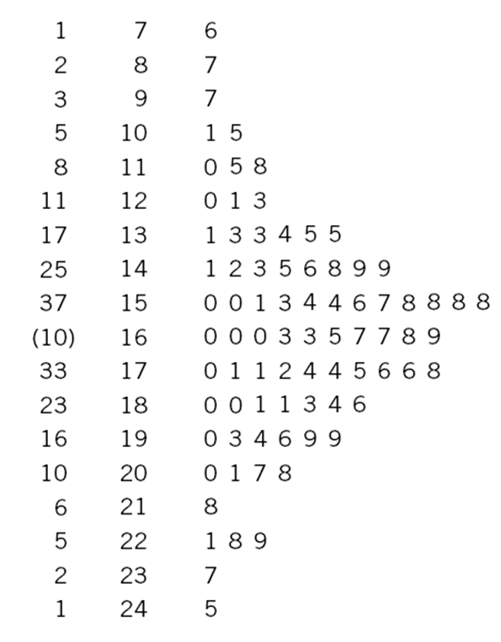
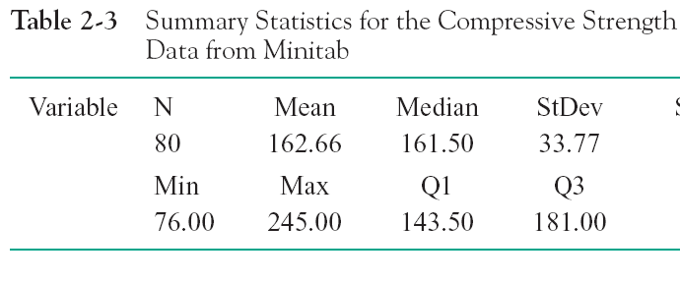
Interpretation

Slide 12
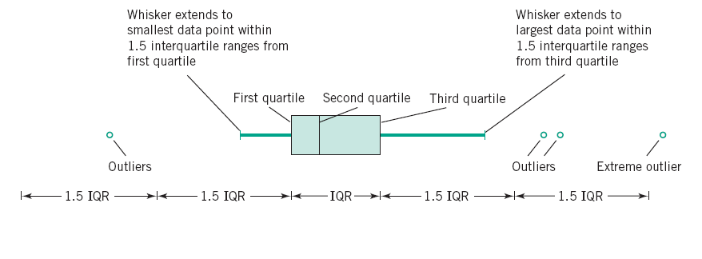

Slide 13
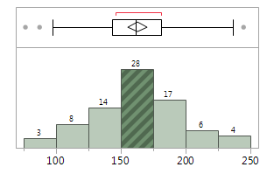
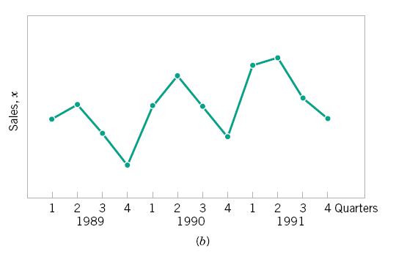

Slide 14
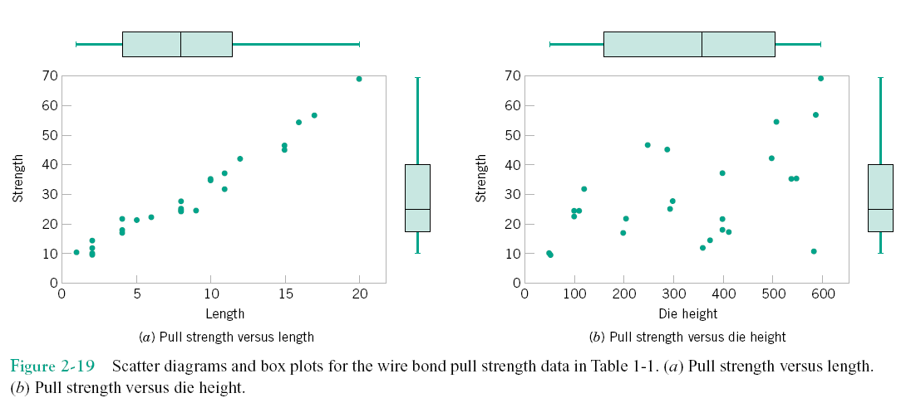

Slide 15
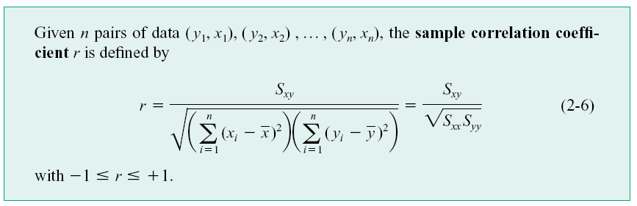

Slide 16
Random Variables
A variable whose measured value can change from one replicate of the experiment to another is referred to as a random variable.
Conductivity of glass from (seemingly) identical experiments.
Age of a randomly selected person in a grocery store.
Temperature of air at a given location on 1st January of every year at 10 am.

Slide 17
Discrete and continuous random variables
Discrete random variables can take values from a finite
Set of discrete numbers.
Continuous random variables can take any value in a
given range.
Number of text messages received in a day.
Number of accidents at an intersection.
The lifetime of a biomedical device after implant in a patient.
The strength of a concrete specimen.

Slide 18
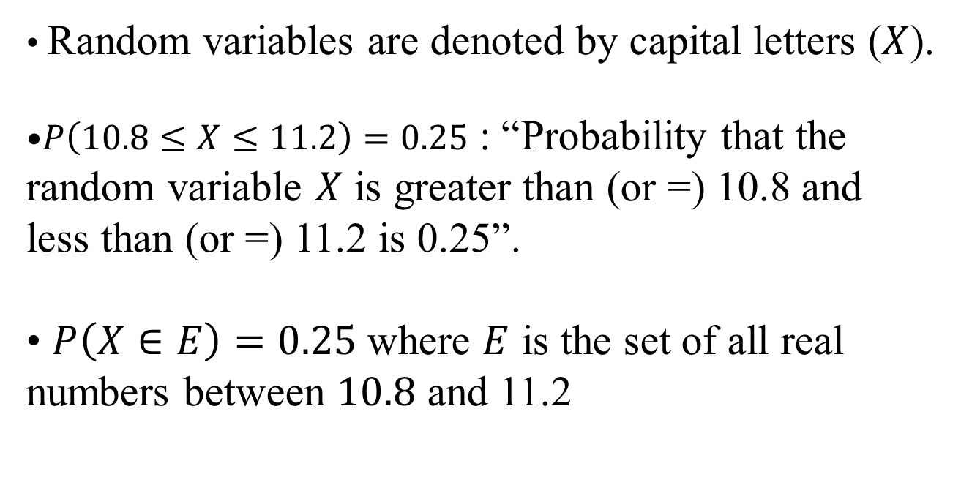
Probability: Notation
Random variables are denoted by capital letters ($X$).
$P\left(10.8≤X≤11.2\right)=0.25$ : “Probability that the random variable $X$ is greater than (or =) 10.8 and less than (or =) 11.2 is 0.25”.
$P\left(X∈E\right)=0.25$ where $E$ is the set of all real numbers between $10.8$ and 11.2
Is a continuous or a discrete random variable?

Slide 19
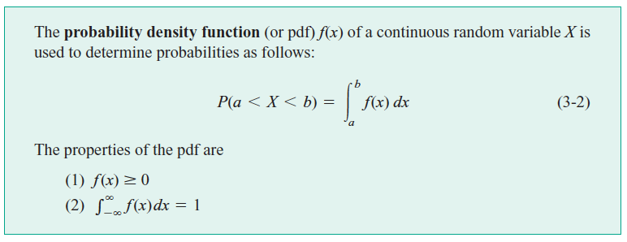
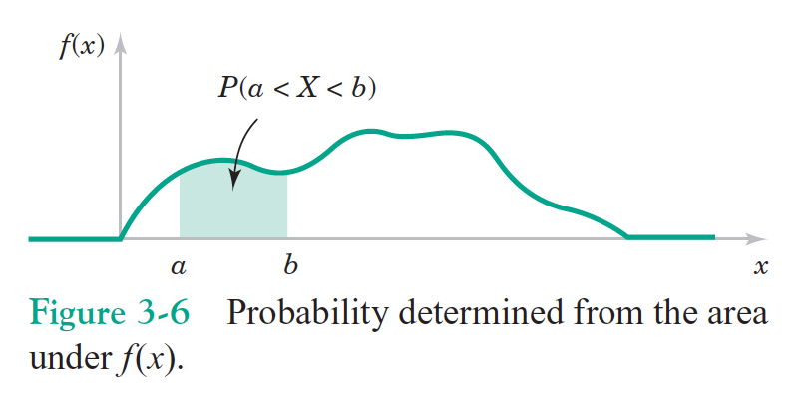
Probability Density Function (pdf)

Slide 20
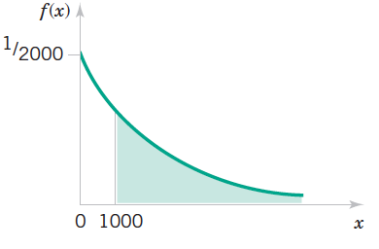
Using cumulative pdf
2000
cumulative of the pdf

Slide 21
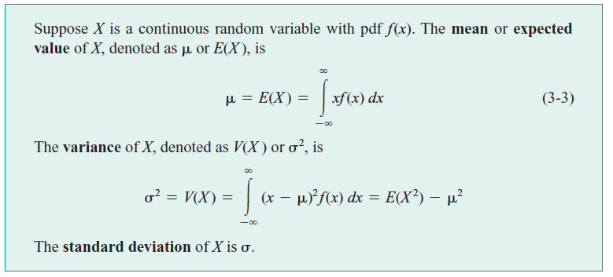
Mean (or Expected value) and Variance

Slide 22
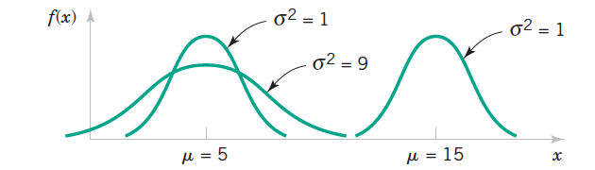

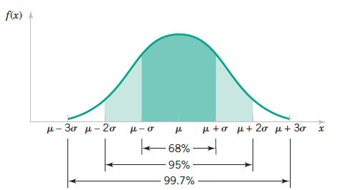
Normal Distribution: Features

Slide 24
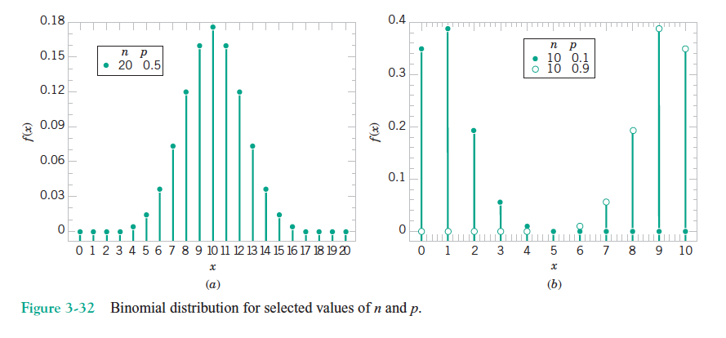

Slide 25
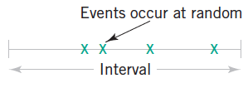
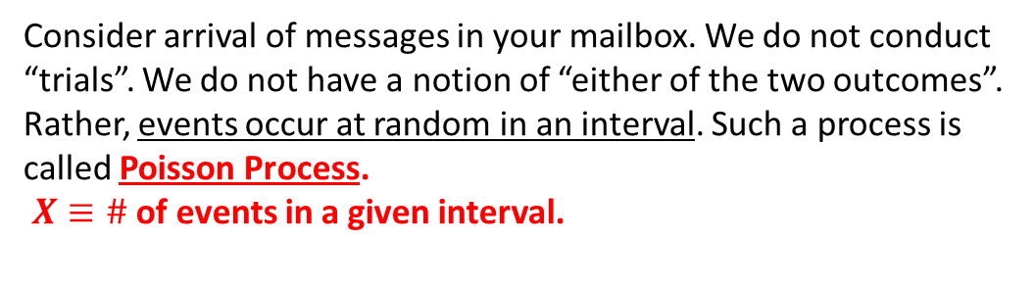
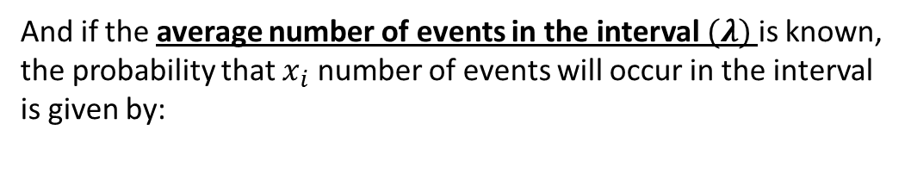
Poisson Process
Consider arrival of messages in your mailbox. We do not conduct
“trials”. We do not have a notion of “either of the two outcomes”.
Rather, events occur at random in an interval. Such a process is
called Poisson Process.
$X≡\#$ of events in a given interval.
And if the average number of events in the interval$(λ)$ is known,
the probability that $x_{i}$ number of events will occur in the interval
is given by:

Slide 26
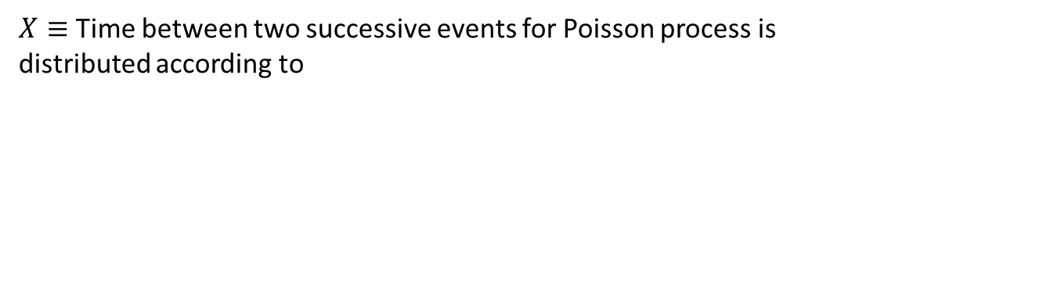
Exponential distribution
$X≡$ Time between two successive events for Poisson process is
distributed according to

Slide 27

Expected value (mean, $μ)$for discrete distribution (Poisson dist.)

Slide 28
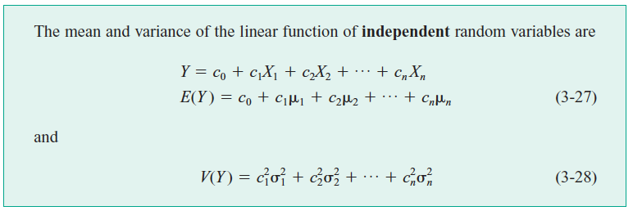
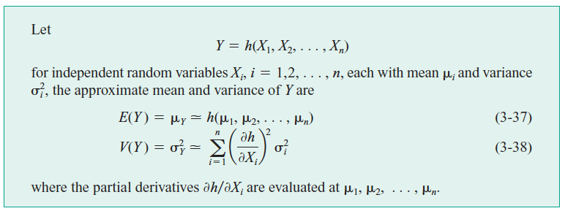

Slide 29

Mean and variance of sample mean
Sample mean is also a random variable
Sample mean of n random variables is defined as:
The expected value of each of the random variable is $μ$
and hence:

Slide 30
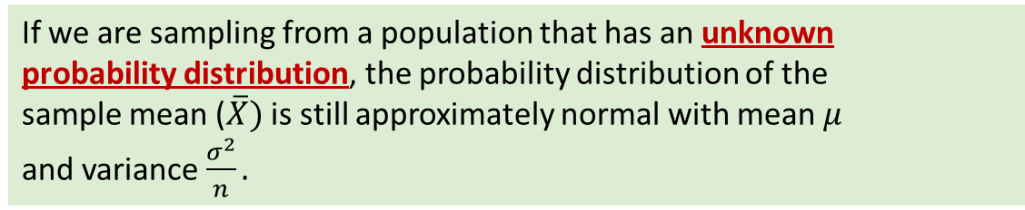
Central Limit Theorem
If we are sampling from a population that has an unknown
probability distribution, the probability distribution of the
sample mean ($\overline{X})$ is still approximately normal with mean $μ$
and variance $\frac{σ^{2}}{n}.$

